Slide 1
Angela’s Ashes Book Talk
By Catie Scott

Slide 2
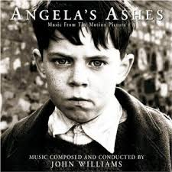
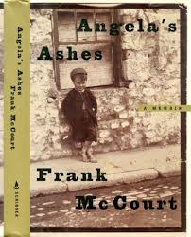
General Information
Title: Angela’s Ashes
Author: Frank McCourt
Genre: Memoir/Autobiography
Copyright Date: 1996

Slide 3
Summary
I haven’t finished it
Frank McCourt and immediate family
Their troubles (poverty, lack of money, drinking)
Neighbors and non-immediate family
McCourts start off New York, New York; they travel to Limerick, Ireland
Autobiography

Slide 4
Read This Because
It may seem boring, but is actually quite enticing
Brings out sympathy, maybe empathy, and lots of emotions
Lots of parts that are unbelievable

Slide 5
Specifics/Details
Frank’s family is in extreme poverty.
They live in the worst possible areas ever.
They are only friends with lots of poor people; the only people with some sort of wealth is the McNamara’s (Angela’s sisters) and Angela’s mom (sends them to Limerick).
This was set during the Great Depression.
Important settings are Brooklyn, New York; Leamy’s National School; Limerick, Ireland;

Slide 6
What I Like
Grammar
No Sugarcoating
The grammar in Angela’s Ashes seems purposefully incorrect at moments.
Make it seem more real?
Written by a child?
In Frank’s situation?
Frank’s life was difficult, so he doesn’t bother sugarcoating the worst parts of it.
Deaths
How he’s treated
Embarrassing parts

Slide 7
Mentor Chunk #1
“My father and mother should’ve stayed in New York where they met and married, and where I was born. Instead, they returned to Ireland when I was four, my brother, Malachy, three, the twins, Oliver and Eugene, barely one, and my sister, Margaret, dead and gone.” (p. 1)
Example of no sugarcoating
Very straightforward
Tells events exactly how they happened
First page

Slide 8
Mentor Chunk #2
“There are seven masters in Leamy’s National School and they all have leather straps, canes, blackthorn sticks. They hit you with the sticks on the shoulders, the back, the legs, and especially, the hands. If they hit you on the hands it’s called a slap. They hit you if you’re late, if you have a leaky nib on your pen, if you laugh, if you talk, and if you don’t know things.” (p. 80)
Another example of no sugarcoating
Amazing difference between then and now
One moment that should evoke emotion
Very young children, too

Slide 9
Mentor Chunk #3
“Even if they slap you six times on each hand with the ash plant or the blackthorn with the knobs you must not cry. You’ll be a sissy. There are boys who might jeer at you and mock you on the street but even they have to be careful because the day will come when the master his and slaps them and they have to keep the tears behind their eyes or be disgraced forever. Some boys say it is better to cry because that pleases the masters. If you don’t cry the masters hate you because you’ve made them look weak before the class and they promise themselves the next time they have you up they’ll draw tears or blood or both.” (p. 81)
More remarkable differences
Example of no sugarcoating
Powerful

Slide 10
This book is . . .
Not action packed, but enticing
A whole mix of emotions
A real story (!!!)
Tragic

